Slide 1
Introduction to Iteration
Merve Ileri-Tayar
R-Ladies St. Louis
10/11/2022

Slide 2
Why should you attend to this workshop?
To learn how to speak to your computer
To understand basic logic of programming

Slide 3
Why do we need iterations?
What does R normally do when running a script?
Often times, you need to do the same thing for several times with multiple inputs or conditions.
Repeating the same operation for different participants, columns, or dataframes…
A loop is a sequence of commands that R will execute over and over again, until some termination criteria are met.
The main aim is to reduce duplication and have more efficient codes.

Slide 4
Why do we need iterations?
To make our code more readable
To save time
To make it easier to change
To reduce errors

Slide 5
Today’s Agenda
Conditional statements
For loops
Writing functions

Slide 6
Conditionals
To switch between different possible commands depending on a condition that is specified.
Condition needs to produce a logical value, either TRUE or FALSE.
It checks to see if the condition is TRUE.
if (CONDITION) {
statement 1
statement 2
…
}

Slide 7

Conditionals
To switch between different possible commands depending on a condition that is specified.
Condition needs to produce a logical value, either TRUE or FALSE.
It checks to see if the condition is TRUE.
Operator | Description
< | less than
<= | less than or equal to
> | greater than
>= | greater than or equal to
== | exactly equal to
!= | not equal to
!x | Not x
x | y | x OR y
x & y | x AND y
if (CONDITION) {
statement 1
statement 2
…
}

Slide 8
Conditionals
To switch between different possible commands depending on a condition that is specified.
Condition needs to produce a logical value, either TRUE or FALSE.
It checks to see if the condition is TRUE.
if (CONDITION) {
statement 1
statement 2
…
}
If the condition is TRUE, it goes on to execute all commands inside the curly brackets from top to bottom.
When it gets to the bottom statement, it stops and continue with the next part of your code.
If the condition is FALSE, it does not execute the commands inside the curly brackets.

Slide 9
Conditionals
To switch between different possible commands depending on a condition that is specified.
Condition needs to produce a logical value, either TRUE or FALSE.
It checks to see if the condition is TRUE.
if (CONDITION) {
statement 1
statement 2
…
} else {
statement 3
statement 4
…
}
If the condition is TRUE, it goes on to execute all commands inside the curly brackets from top to bottom.
If the condition is FALSE, it goes on to execute the commands inside the «else» curly brackets.

Slide 10
Conditionals
To switch between different possible commands depending on a condition that is specified.
if (CONDITION 1) {
statement 1
statement 2
…
} else if (CONDITION 2) {
statement 3
statement 4
…
} else {
statement 5
…
}
We can also add another condition that will be checked if the first condition is not met.
If the first condition is FALSE, but the second condition is TRUE, it goes on to execute the commands inside the «else if» curly brackets.
If none of the conditions are TRUE, it goes on to execute the commands inside the «else» curly brackets.

Slide 11
Do we really use conditionals?
Yes!

Slide 12
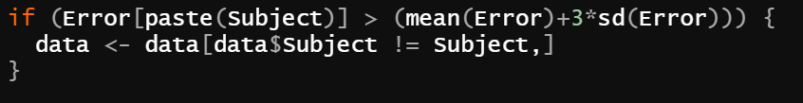
Do we really use conditionals?
Yes!

Slide 13
Conditionals
Let’s do some exercise in R!

Slide 14
The For Loop
To run a set of statements for a fixed number of times
Each element of the vector corresponds to a possible value of the variable VAR.
In the first iteration of the loop, VAR is given the value that is the first element of the VECTOR.
for (VAR in VECTOR) {
statement 1
statement 2
…
}
The statements run in the case that VAR is equal to the first element of the VECTOR.
When it gets to the bottom statement, it moves back up to the for statement, and update the value of the VAR as the second element of the VECTOR.
Once all of the values in VECTOR is exhausted, the loop terminates.

Slide 15
The For Loop
To run a set of statements for a fixed number of times
for (VAR in VECTOR) {
statement 1
statement 2
…
break
}
With the break statement, we can stop the loop before it exhausted all the items in VECTOR.
Useful when combined with conditionals

Slide 16
The For Loop
To run a set of statements for a fixed number of times
for (VAR in VECTOR) {
statement 1
next
statement 2
…
}
With the next statement, we can skip an iteration without terminating the loop.
Useful when combined with conditionals

Slide 17
Do we really use the for loop?
Yes!

Slide 18
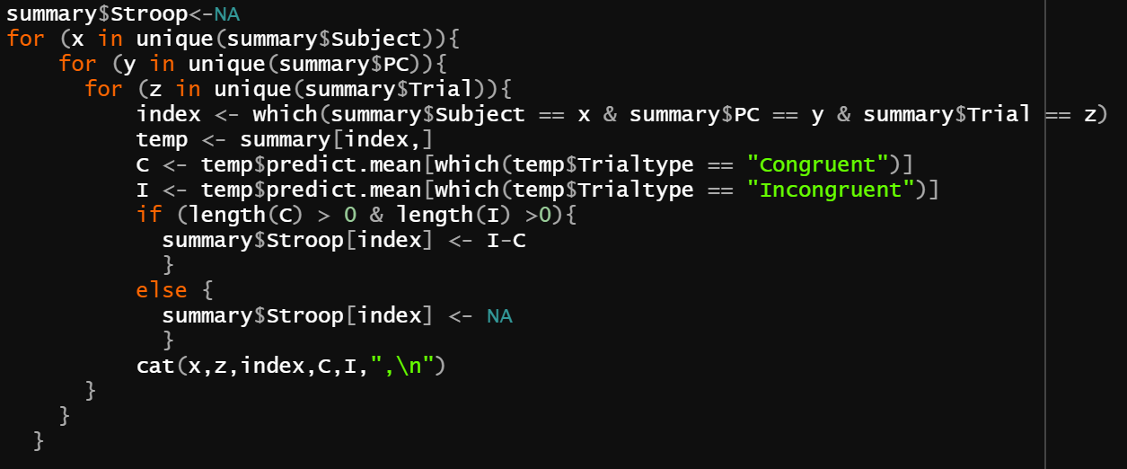
Do we really use the for loop?
Yes!

Slide 19
The For Loop
Let’s do some exercise in R!

Slide 20
Writing Functions
To create your own functions
You define the arguments that will be used in this function.
The order is important!
FunctionName <- function (ARG1, ARG2, …) {
statement 1
statement 2
…
return(VALUE)
}
Whenever the function is called, R executes the statements in the curly brackets, and return the output value.
Internal statements in the body of the function are executed in a temporary local environment and remain invisible to the user.
Only the final result (VALUE) is returned to the workspace.

Slide 21
Writing Functions
After you create your functions, you can save them in an .R script.
It is useful to save your related functions in a file so that you can use them later.
When you need to use these functions again, you can call your file using the source() function and access those functions again!

Slide 22
Do we really write functions?
Yes!
Notes:
From Rmisc package

Slide 23
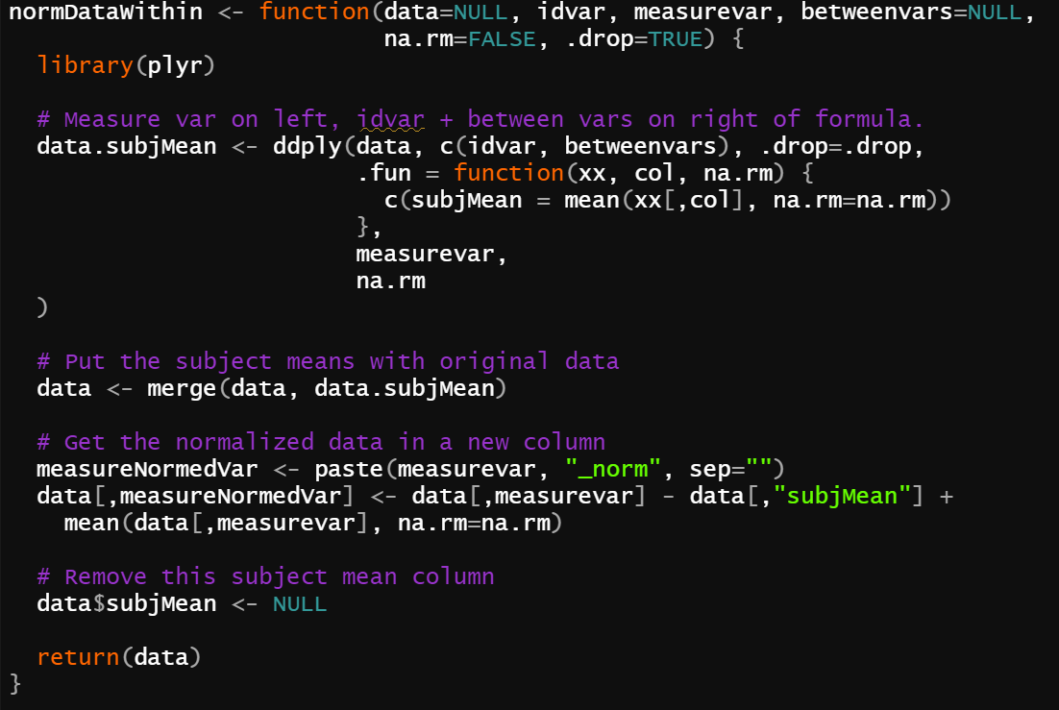
Do we really write functions?
From Rmisc package
Yes!
Notes:
From Rmisc package

Slide 24
Writing Functions
Let’s do some exercise in R!

Slide 25
Thank you!
Any questions?
E-mail: i.merve@wustl.edu

Slide 26
Extras!

Slide 27
The While Loop
To run a set of statements as long as a condition is met
Condition needs to produce a logical value, either TRUE or FALSE.
It checks to see if the condition is TRUE.
while (CONDITION) {
statement 1
statement 2
…
}
If the condition is TRUE, it goes on to execute all commands inside the curly brackets from top to bottom.
When it gets to the bottom statement, it moves back up to the while statement and check the condition again.
This continues until at some point the condition turns out to be FALSE.

Slide 28
The While Loop
To run a set of statements as long as a condition is met
while (CONDITION) {
statement 1
statement 2
…
break
}
With the break statement, we can stop the loop even if the while condition is TRUE.
Useful when combined with conditionals

Slide 29
The While Loop
To run a set of statements as long as a condition is met
while (CONDITION) {
statement 1
next
statement 2
…
}
With the next statement, we can skip an iteration without terminating the loop.
Useful when combined with conditionals

Slide 30
Implicit Loops
Implicit loop functions do the same calculations simpler than the corresponding explicit loops.
apply(), lapply(), sapply(), tapply()
See the explanations and examples in R!

